Slide 1
Classification
Ban 764 Machine Learning for Business Analytics

Slide 2
The Dataset
In this lecture, we will be using the MNIST dataset
A set of 70,000 small images of digits handwritten by high school students and employees of the US Census Bureau.
The “Hello World” of Machine Learning:
whenever people come up with a new classification algorithm, they are curious to see how it will perform on MNIST.
Whenever someone learns Machine Learning, sooner or later they tackle MNIST.
Each image is labeled with the digit it represents.

Slide 3
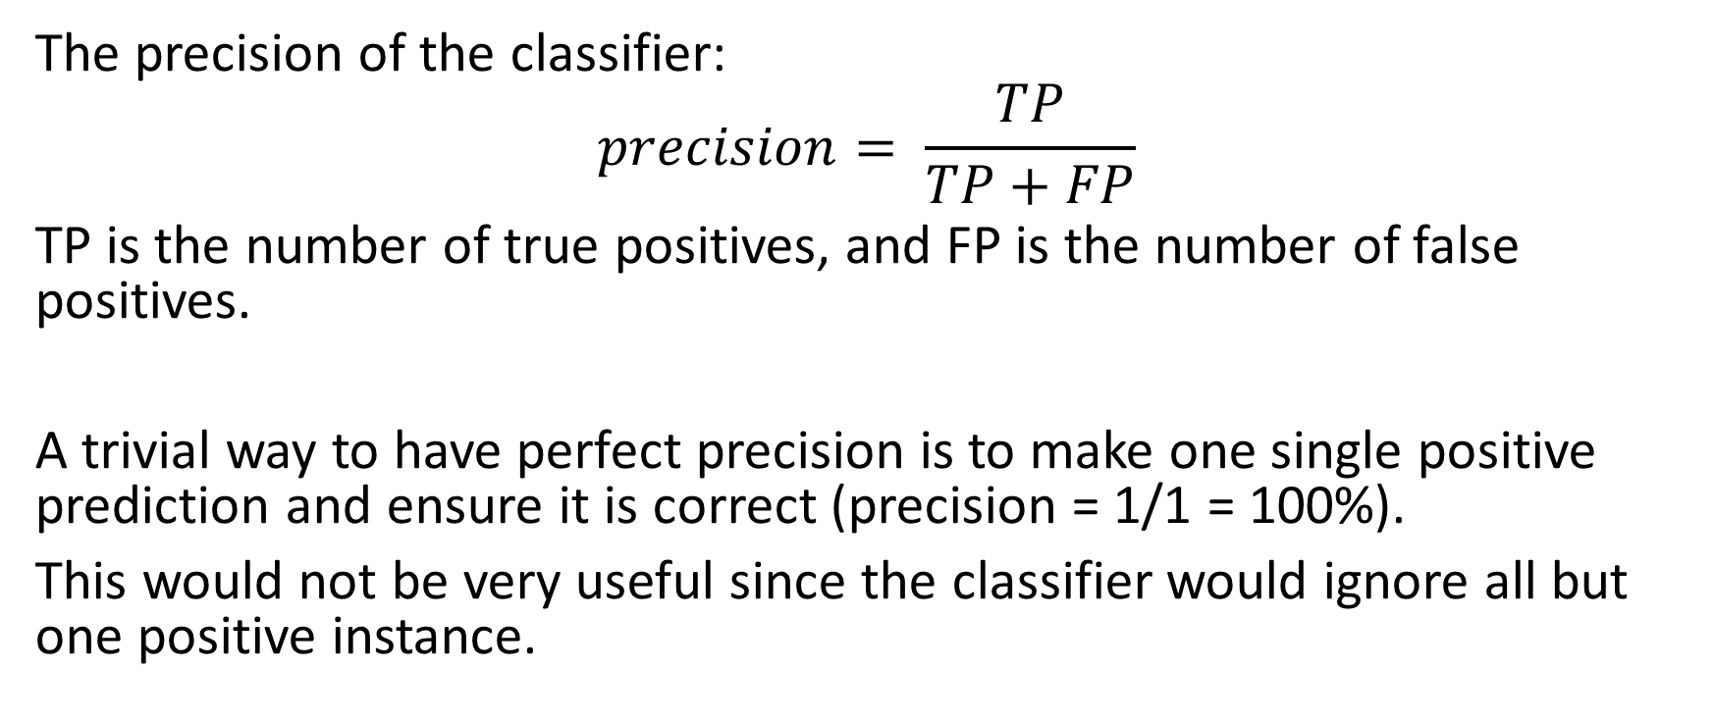
Precision
The precision of the classifier:
$$precision= \frac{TP}{TP+FP}$$
TP is the number of true positives, and FP is the number of false positives.
A trivial way to have perfect precision is to make one single positive prediction and ensure it is correct (precision = 1/1 = 100%).
This would not be very useful since the classifier would ignore all but one positive instance.

Slide 4

Recall
So precision is typically used along with another metric named recall, also called sensitivity or true positive rate (TPR):
$$recall= \frac{TP}{TP+FN}$$
FN is of course the number of false negatives.

Slide 5
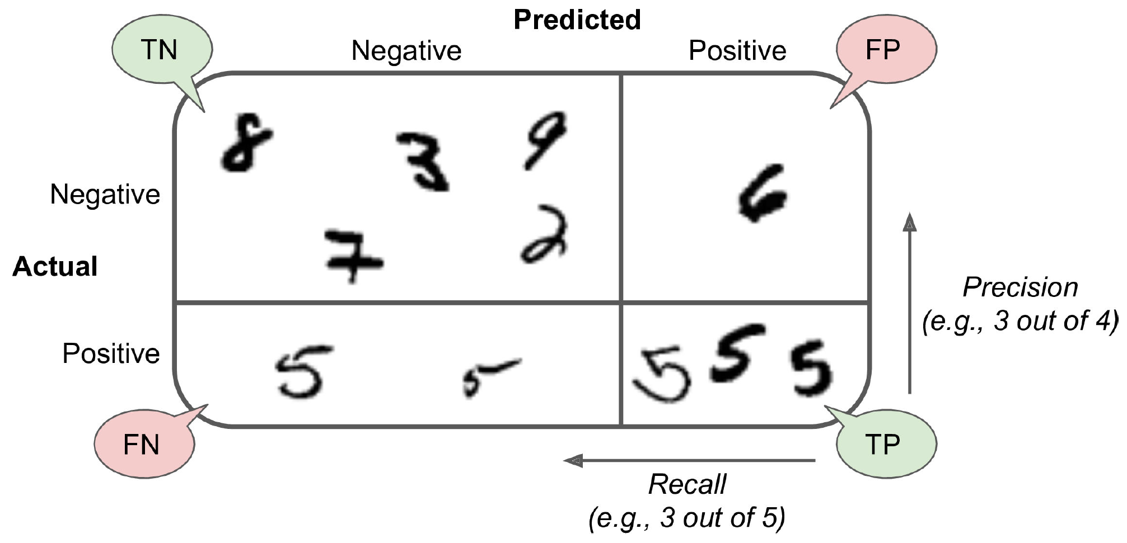
Precision and Recall

Slide 6
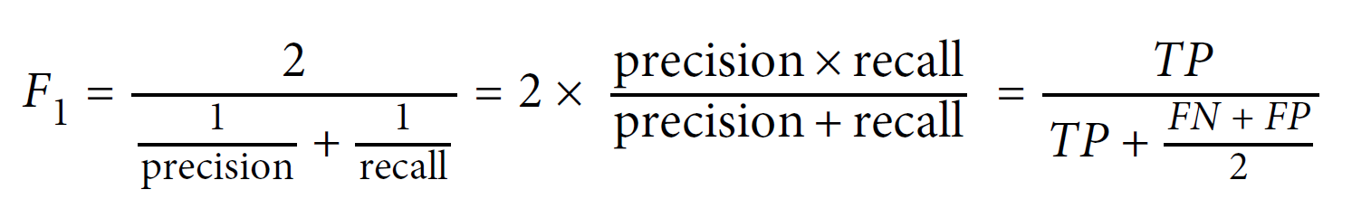
F1 Score
It is often convenient to combine precision and recall into a single metric called the F1 score, in particular, if you need a simple way to compare two classifiers.
The F1 score is the harmonic mean of precision and recall.

Slide 7
The Precision/Recall Trade-off
The F1 score favors classifiers that have similar precision and recall.
This is not always what you want:
in some contexts, you mostly care about precision, and
in other contexts, you really care about recall.
For example:
if you trained a classifier to detect videos that are safe for kids: high precision;
train a classifier to detect shoplifters on surveillance images: high recall.

Slide 8
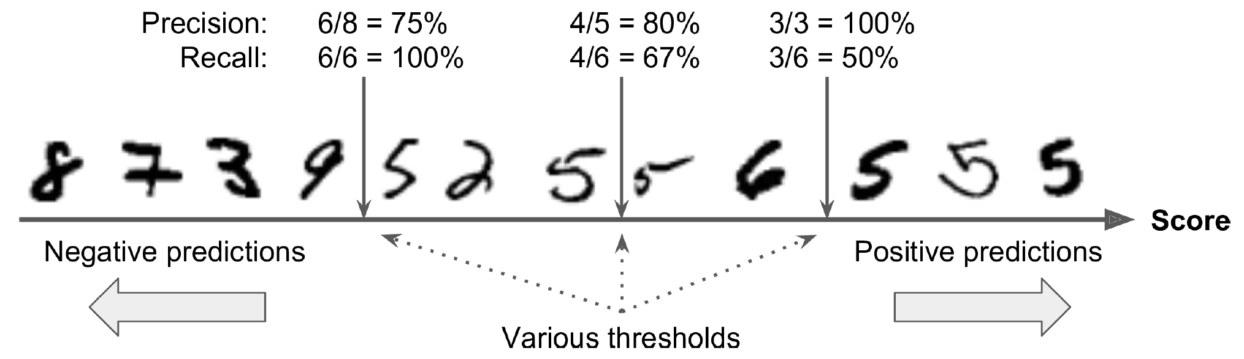
The Precision/Recall Trade-off
To understand this tradeoff, let’s look at how the SGDClassifier makes its classification decisions.
For each instance, it computes a score based on a decision function, and
if that score is greater than a threshold, it assigns the instance to the positive class,
or else it assigns it to the negative class.

